Slide 1
International Student Experience 2022

Slide 2
Methodology
An online survey was conducted between 20th May – 14th June 2022
595 responses received
Covered agents, accommodation, induction, current experience, HSU, Wellbeing and finances
25 online depth qualitative interviews ran between 6th June – 28th June 2022
Variety of gender, School of study, country of origin and level of study

Slide 3
Pre-arrival
51% of international students only found suitable accommodation after arriving the UK
Vital information on accommodation arrangements, financial guidance, travel and FAQ’s often overlooked in bulky emails
Did not receive enough information on who to contact if they have questions/queries
Some experienced poor response times
Many students had to live with family/friends already in the UK while studying
This was an essential lifeline for many unable to find accommodation prior to arrival

Slide 4
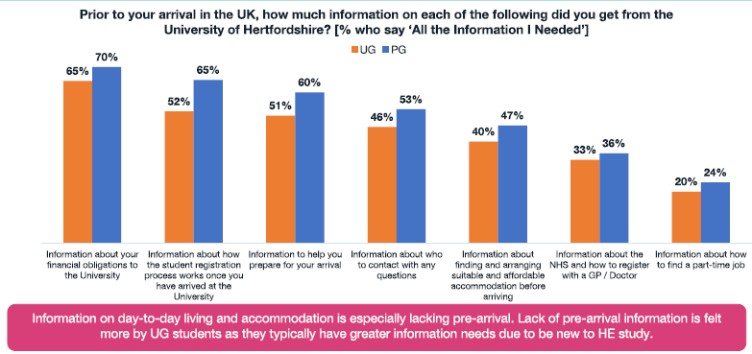
Overall Pre-Arrival Experience

Slide 5
Accommodation
77% of International students dissatisfied with their accommodation are dissatisfied with the price
63% of International students live in privately rented properties during term-time
Unable to secure off-campus accommodation
Struggles to rent privately due to lack of UK guarantor
Had to choose university accommodation in some cases, though this was less preferred option
Cost of University Halls is off-putting
Some opting for twin rooms to reduce costs, but impacts overall satisfaction and experience
Lack of detail for on-campus accommodation, specifically around bathrooms, laundry etc. perceived to be crucial for those unable to visit in-person

Slide 6
Key Information
Local knowledge
Transport options, local amenities, how to sign up for local GP and NHS services
‘when I arrived, I was starving and didn’t know where to buy food’, ‘Where can I buy adapters for charging all my devices? This was a problem, and I couldn’t find any information’
Transport upon arrival
Frequent topic in interviews, many students arriving without knowing how to get to campus, resulting in expensive taxis (£60-80 on average)
‘ I didn’t have a contact number for anyone at the university, so had to get a taxi’, ‘We didn’t know there was airport pick ups’
Part-Time work
Crucial for students planning to live off-campus
‘Some of my friends have had to move far away from campus to find part-time work and as a result have a long commute to class.’

Slide 7
Agents
51% of students spoke to an agent during their application process
Reasons for using Agents: - Many preferred to write their application/personal statement in their native language and use the facility of translating to English provided by their Agent. - Largely used to simplify the application process, finding suitable university, outlining timelines and requirements
‘They offered me a lot of universities in the UK. And we decided to try to apply in University of Hertfordshire. So then they translated all my documents, helped me to take online exams.’
Reasons for not using Agents:
- These students cited they either had family members to assist them, were well-versed in the application process, or were already proficient in English speaking

Slide 8
Course Experience
UK Education style/essay expectations
Students often struggle adjusting to UK style of teaching and learning, more emphasis on research, independent thought and debate
Translates into struggles with writing essays
Managing responsibilities
Juggling part-time work and academic work causes issues for students, who feel course leaders are not understanding of this
Language barriers
Some found the language barrier difficult especially in complex modules with technical terminology
‘In class, we couldn’t understand sometimes what they were saying, and the interaction will just decrease the quality of the overall lecture.’

Slide 9
Concerns and Wellbeing

Slide 10
Finances
58% of International students’ main reason for not being able to pay fees is related to family emergency
Some report managing multiple commitments in order to cope financially has vast impacts on their academics, with struggles not recognized or accommodated sufficiently
Ability to pay for fees is often out of students’ hands
Family emergencies, unforeseen circumstances and political issues are often reasons for inability to keep up with tuition fees
Greater understanding and higher visibility of solutions offered wanted
Knowledge of the Finance team is low and not utilised by many
Those that did seek support were less likely to receive StudyNet bans
‘Because of a banking policy issue in my home country I couldn’t pay my fees but the finance team ensured I was not locked out of StudyNet.’

Slide 11
Thank You

